Slide 1




Consumer Goods Ad Hoc Insights
Atliq Hardware
By rohit kumar s

Slide 2
Atliq Hardware
Introduction:
AtliQ Hardware is a company that supplies computer hardware and peripherals to many clients across India and well expanded in other countries too.
The goal of this project:
The analytical team gave us the assignment to create a report on 10 ad-hoc requests because AtliQ Hardware wants to do an ad-hoc analysis.
To give useful insight to our stakeholders and assist our organization in making data-driven decisions for the expansion of their business, we executed 10 ad-hoc SQL requests.

Slide 3
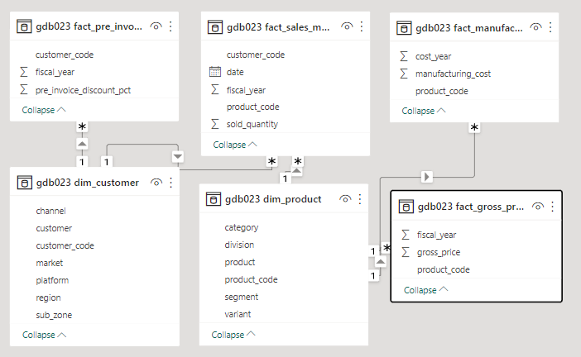
The given relational database consists of 6 tables:
Dim customer: Data related to customers.
Dim product: Data related to products.
Fact gross price: The gross price of each product.
Fact_manufacturing_cost: Manufacturing cost of each product during production.
Fact_pre_invoice_deduction: Pre-invoice deduction of each product.
Fact_sales_monthly: This table contains monthly sales of each product
Data model:

Slide 4
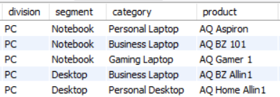
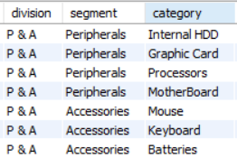
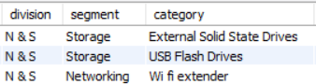
AtliQ Hardware division of products:
PC - Personal computer
N & S - Network and Storage
P & A – Peripherals and Accessories
There are 2 segments with 4 category of product in PC.
There are 2 segments with 7 category of product in P & A.
There are 2 segments with 3 category of product in N & S.

Slide 5
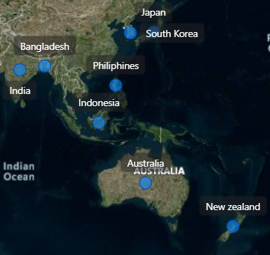
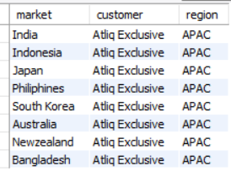
1. Provide the list of markets in which customer "Atliq Exclusive" operates its business in the APAC region.
Query
select distinct market, customer, region
From dim_customer where customer = 'Atliq Exclusive' and region = 'APAC';
Output
INSIGHTS
In the APAC region, "Atliq Exclusive" operates its business in 8 different countries. The markets are India, Indonesia, Japan, Philippines, South Korea, Australia, New Zealand, and Bangladesh.

Slide 6
2. What is the percentage of unique product increase in 2021 vs. 2020? The final output contains these fields unique_products_2020 unique_products_2021 percentage_chg
Query
with product_count_2020 as (
select count(distinct product_code) as product_2020 from fact_sales_monthly where fiscal_year = 2020),
product_count_2021 as (select count(distinct product_code) as product_2021from fact_sales_monthly where fiscal_year = 2021),
percentage as (select(((pc21.product_2021 - pc20.product_2020) / pc20.product_2020) * 100) as percentage_chg
from product_count_2020 pc20, product_count_2021 pc21)
select pc20.product_2020 as unique_products_2020, pc21.product_2021 as unique_products_2021, p.percentage_chg
from product_count_2020 pc20, product_count_2021 pc21, percentage p;

Slide 7
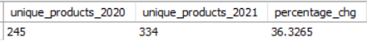
Output
INSIGHTS
From 2020 to 2021 Count of unique products is increased by 36%

Slide 8
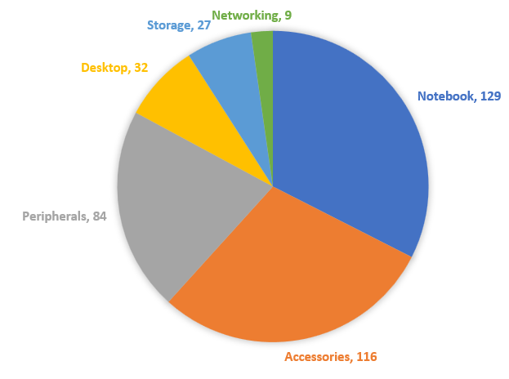
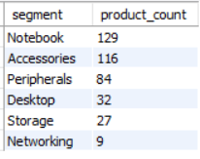
3. Provide a report with all the unique product counts for each segment and sort them in descending order of product counts. The final output contains 2 fields, segment
product_count
Query
select segment, count(distinct product_code) as product_count
from dim_product group by segment order by product_count desc;
Output:
INSIGHTS
Notebook and Accessories are the top 2 segments over 6 segments.

Slide 9
4. Follow-up: Which segment had the most increase in unique products in 2021 vs 2020? The final output contains these fields, segment
product_count_2020 product_count_2021
difference
Query
with prod_2020 as (select dp.segment, dp.product_code, count(distinct dp.product_code) as product_count_2020
from dim_product dp join fact_sales_monthly on dp.product_code = fact_sales_monthly.product_code
where fiscal_year = 2020 group by segment),
prod_2021 as (select dp.segment, dp.product_code, count(distinct dp.product_code) as product_count_2021
from dim_product dp join fact_sales_monthly on dp.product_code = fact_sales_monthly.product_code
where fiscal_year = 2021 group by segment)
select pc20.segment, pc20.product_count_2020, pc21.product_count_2021,
(pc21.product_count_2021 - pc20.product_count_2020) as difference
from prod_2020 pc20 join prod_2021 pc21 using(segment) order by difference desc;

Slide 10
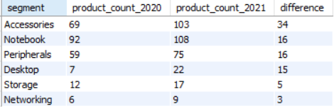
Output:
INSIGHTS
There are 34 new accessories products from 2020 to 2021 than other segments. Notebooks and peripherals are increased by 16 new products.

Slide 11


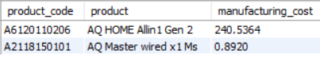
5. Get the products that have the highest and lowest manufacturing costs. The final output should contain these fields, product_code
product
manufacturing_cost
Query
select product_code, dim_product.product, manufacturing_cost
from fact_manufacturing_cost join dim_product using(product_code)
where manufacturing_cost
in(select max(manufacturing_cost) from fact_manufacturing_cost
union
select min(manufacturing_cost) from fact_manufacturing_cost)
order by manufacturing_cost desc;
AQ HOME Allin1 Gen2
Highest manufacturing cost
Output:
AQ Master wired x1 Ms
Lowest manufacturing cost

Slide 12
6. Generate a report which contains the top 5 customers who received an average high pre_invoice_discount_pct for the fiscal year 2021 and in the Indian market. The final output contains these fields, customer_code
customer average_discount_percentage
Query
select F.customer_code, dim_customer.customer, f.pre_invoice_discount_pct*100 as average_discount_percentage
from fact_pre_invoice_deductions f join dim_customer using(customer_code)
where f.fiscal_year = 2021 and dim_customer.market= 'india’
group by F.customer_code, dim_customer.customer
order by f.pre_invoice_discount_pct*100 desc limit 5;

Slide 13
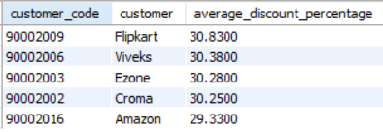
Output:
INSIGHTS
Flipkart, Viveks, Ezone, Croma, and Amazon are the top 5 customers who received the maximum discount in India in the year 2021.

Slide 14
7. Get the complete report of the Gross sales amount for the customer “Atliq Exclusive” for each month. This analysis helps to get an idea of low and high-performing months and take strategic decisions. The final report contains these columns: Month
Year
Gross sales Amount
Query
select month(f.date) as Month, year(f.date) as Year, round(sum(fg.gross_price * f.sold_quantity)) as Gross_sales_Amount from fact_gross_price fg join fact_sales_monthly f using(product_code) join dim_customer d using(customer_code)
where d.customer = 'Atliq Exclusive' group by year(f.date), month(f.date)
order by year(f.date), month(f.date);

Slide 15
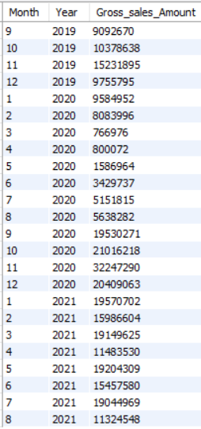
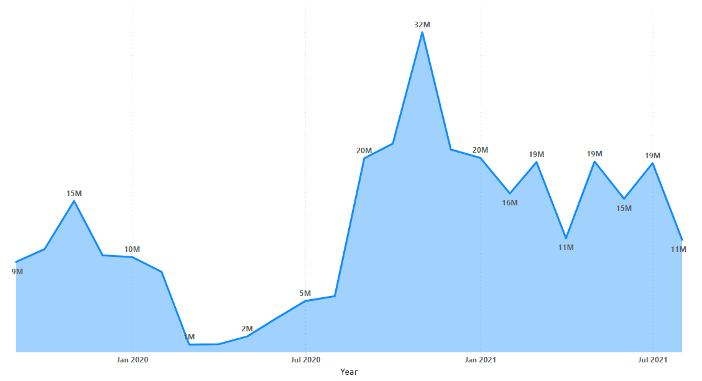
Output:
Gross sales by month-year graph

Slide 16
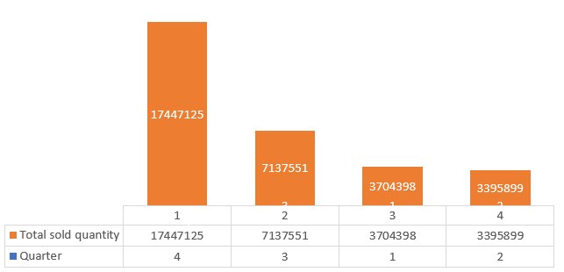
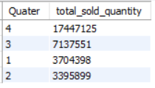
8. In which quarter of 2020, got the maximum total_sold_quantity? The final output contains these fields sorted by the total_sold_quantity, Quarter
total_sold_quantity
Query
select quarter(date) as Quater, sum(sold_quantity) as total_sold_quantity
from fact_sales_monthly where year(date) = 2020
group by quarter(date) order by sum(sold_quantity) desc;
Output:
Insights
4 and 3 quarters are the most quantity sold in the year 2020 than 2 and 1 quarters.

Slide 17
9. Which channel helped to bring more gross sales in the fiscal year 2021 and the percentage of contribution? The final output contains these fields, channel gross_sales_mln percentage
Query
with channel_gross as(
select d.channel, round(sum(fg.gross_price * f.sold_quantity)) as gross_sales_mln
from fact_gross_price fg join fact_sales_monthly f using(product_code) join dim_customer d using(customer_code) where year(f.date) = 2021 group by d.channel)
select channel, gross_sales_mln, round((gross_sales_mln*100/sum(gross_sales_mln) over()),1) as percentage
from channel_gross
group by channel order by percentage desc;

Slide 18
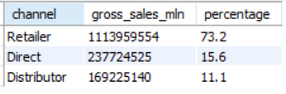
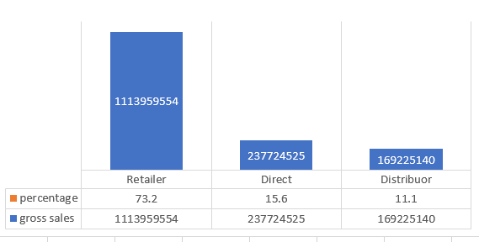
Output:
Insights
73% of the gross sale is done by retailers in the year 2021. direct and distributors contributed by 10-15% in 2021

Slide 19
10. Get the Top 3 products in each division that have a high total_sold_quantity in the fiscal_year 2021? The final output contains these fields, division
product_code
product total_sold_quantity rank_order
Query
with top_3 as(
select d.division, d.product_code, d.product, sum(fs.sold_quantity) as total_sold_quantity,
dense_rank()
OVER ( partition by d.division order by sum(fs.sold_quantity) desc ) as Rank_order
from fact_sales_monthly fs join dim_product d
using(product_code) where year( fs.date ) = 2021
group by d.division, d.product_code, d.product)
select * from top_3 where Rank_order < 4

Slide 20
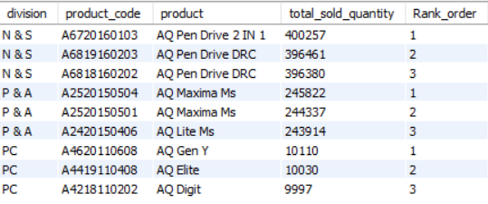
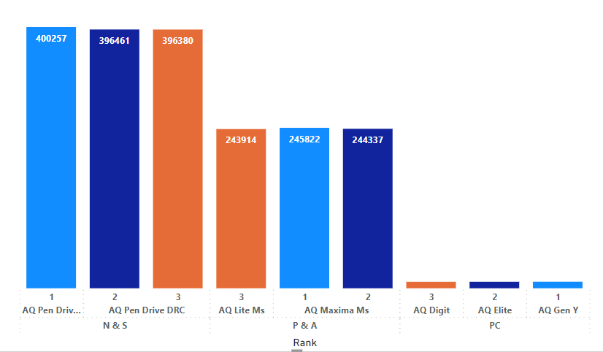
Output:
Insights
Most number of products sold in the N & S (network and storage)division in the year 2021.

Slide 21
Please provide your thoughts and suggestions for this project.
It is beneficial to my skill improvement.
Many thanks

